Slide 1
Static Routing
Routing Protocols and Concepts – Chapter 2

Slide 2
Objectives
Define the general role a router plays in networks.
Describe the directly connected networks, different router interfaces
Examine directly connected networks in the routing table and use the CDP protocol
Describe static routes with exit interfaces
Describe summary and default route
Examine how packets get forwarded when using static routes
Identify how to manage and troubleshoot static routes

Slide 3
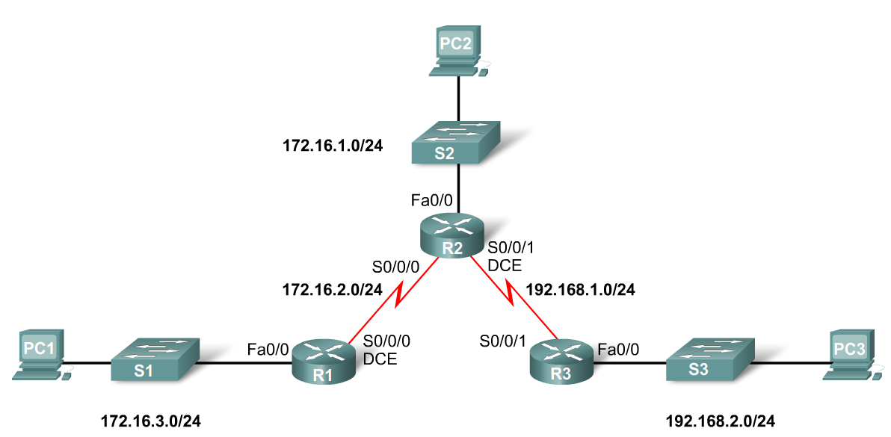
General Role of the Router
Functions of a Router
  Best Path Selections
  Forwarding packets to destination
Introducing the Topology
  3 1800 series routers connected via WAN links
  Each router connected to a LAN represented by a switch and a PC

Slide 4
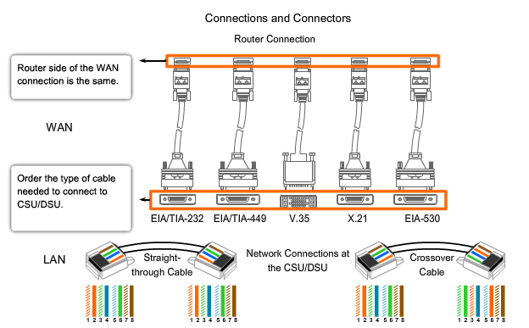
WAN + LAN Connections

Slide 5
General Role of the Router
Connections of a Router for WAN
  -A router has a DB-60 port that can support 5 different cabling standards
Connections of a Router for Ethernet
  -2 types of connectors can be used: Straight through and Cross-over
  Straight through used to connect:
    -Switch-to-Router, Switch-to-PC, Router-to-Server, Hub-to-PC, Hub-to-Server
  Cross-over used to connect:
    -Switch-to-Switch, PC-to-PC, Switch-to-Hub, Hub-to-Hub, Router-to-Router
Notes:
Use Graphic 2.1.3.1

Slide 6
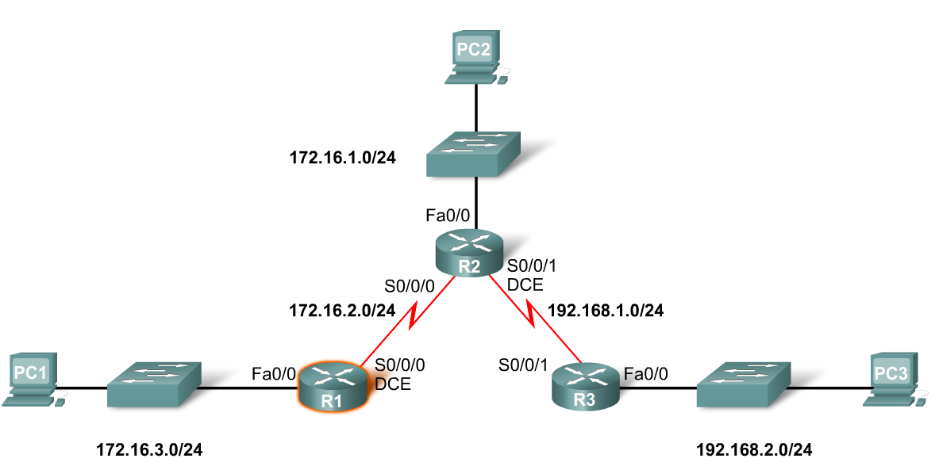
Interfaces
Examining Router Interfaces
  -Show IP router command – used to view routing table
  -Show Interfaces command – used to show status of an interface
  -Show IP Interface brief command – used to show a portion of the interface information
  -Show running-config command – used to show configuration file in RAM

Slide 7
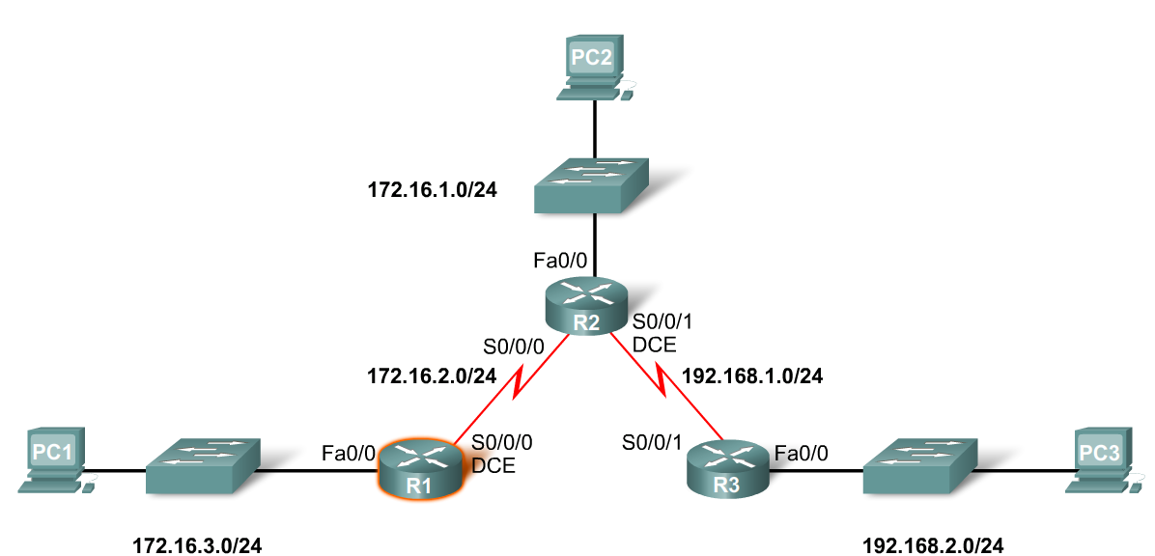
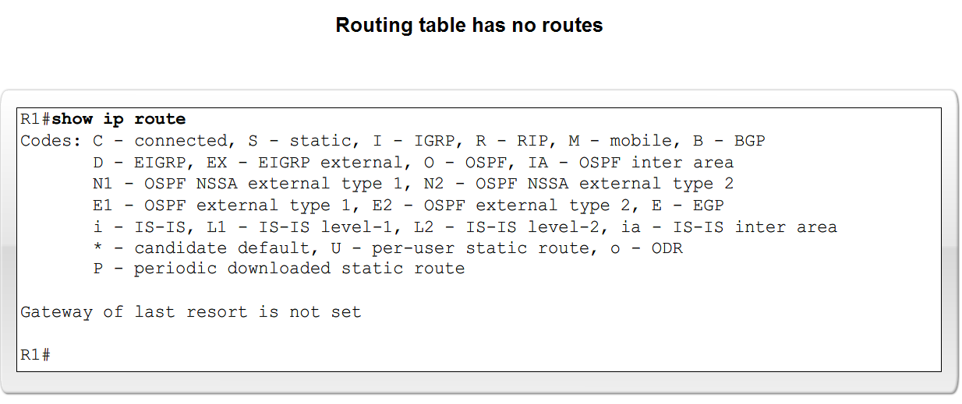
Interfaces
Configuring an Ethernet interface
  -By default all serial and Ethernet interfaces are down
  -To enable an interface use the No Shutdown command

Slide 8
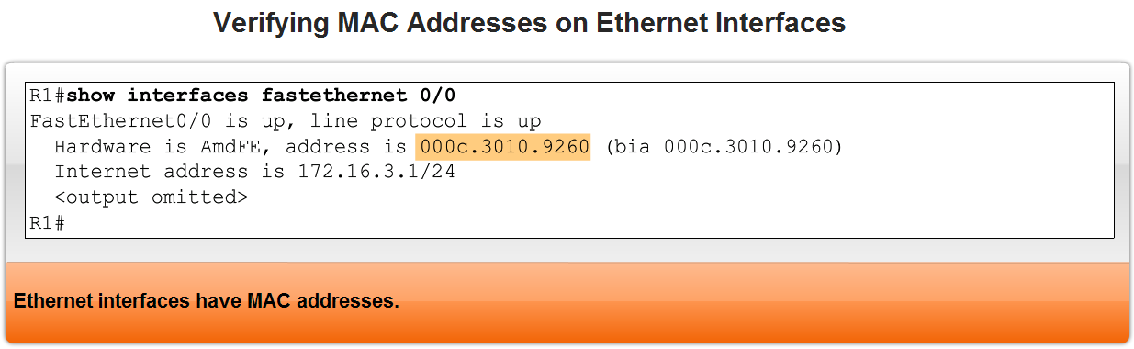
Interfaces
Verifying Ethernet interface
  -Show interfaces for fastEthernet 0/0 – command used to show status of fast Ethernet port
  -Show ip interface brief
  -Show running-config
Ethernet interfaces participate in ARP

Slide 9
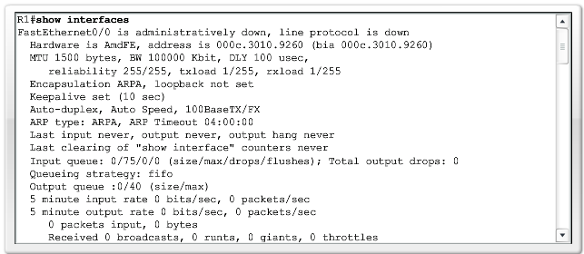
Show Interface Command

Slide 10
Show Interfaces Command
R1#show interfaces fastethernet 0/0
FastEthernet0/0 is administratively down, line protocol is down
Notice that the interface is administratively down and the line protocol is down.
Administratively down means that the interface is currently in the shutdown mode, or turned off.
Line protocol is down means, in this case, that the interface is not receiving a carrier signal from a switch or the hub. This condition may also be due to the fact that the interface is in shutdown mode.
You will notice that the show interfaces command does not show any IP addresses on R1's interfaces. The reason for this is because we have not yet configured IP addresses on any of the interfaces.

Slide 11
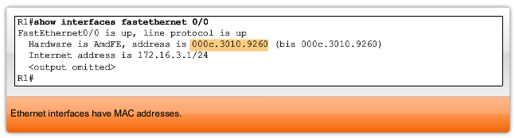
Interfaces and MAC

Slide 12
Interfaces and ARP
An Ethernet interface participates in ARP requests and replies and maintains an ARP table.
If a router has a packet destined for a device on a directly connected Ethernet network, it checks the ARP table for an entry with that destination IP address in order to map it to the MAC address.
If the ARP table does not contain this IP address, the Ethernet interface sends out an ARP request.
The device with the destination IP address sends back an ARP reply that lists its MAC address.
The IP address and MAC address information is then added to the ARP table for that Ethernet interface.
The router is now able to encapsulate the IP packet into an Ethernet frame with the destination MAC address from its ARP table.
The Ethernet frame, with the encapsulated packet, is then sent via that Ethernet interface.

Slide 13
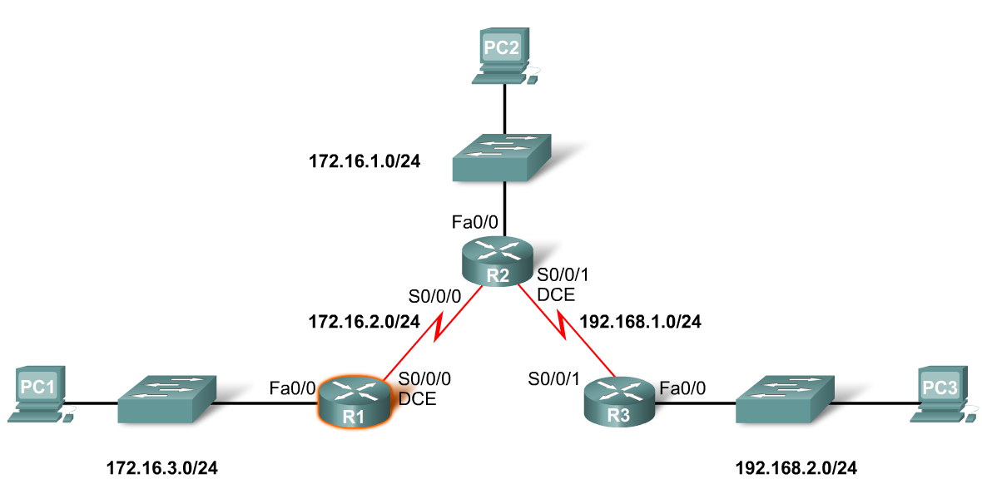
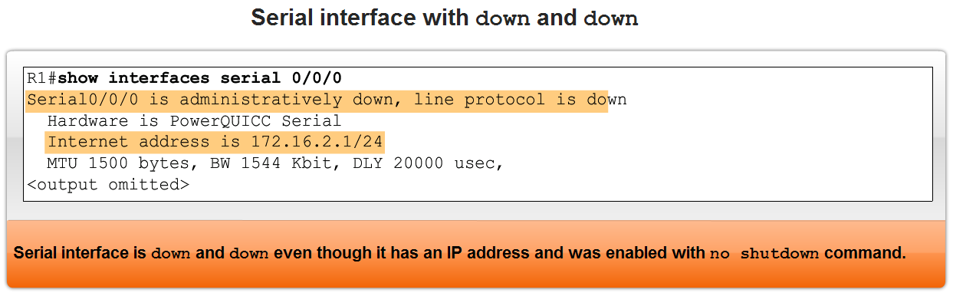
Interfaces
Configuring a Serial interface
  -Enter interface configuration mode
  -Enter in the ip address and subnet mask
  -Enter in the no shutdown command
Example:
  -R1(config)#interface serial 0/0
  -R1(config-if)#ip address 172.16.2.1 255.255.255.0
  -R1(config-if)#no shutdown

Slide 14
Interfaces
Examining Router Interfaces
  -Physically connecting a WAN Interface.
  -A WAN Physical Layer connection has sides:
    Data Circuit-terminating Equipment (DCE) – This is the service provider. CSU/DSU is a DCE device.
    Data Terminal Equipment (DTE) – Typically the router is the DTE device.
Notes:
Use graphic 2.2.5.1….would suggest modifying graphic such that each component is identified prior to placing on slide

Slide 15
DCE + DTE
Typically, the router is the DTE device and is connected to a CSU/DSU, which is the DCE device.
The CSU/DSU (DCE device) is used to convert the data from the router (DTE device) into a form acceptable to the WAN service provider.
The CSU/DSU (DCE device) is also responsible for converting the data from the WAN service provider into a form acceptable by the router (DTE device).
The router is usually connected to the CSU/DSU using a serial DTE cable, as shown.
Serial interfaces require a clock signal to control the timing of the communications.
In most environments, the service provider (a DCE device such as a CSU/DSU) will provide the clock. By default, Cisco routers are DTE devices.
However, in a lab environment, we are not using any CSU/DSUs and, of course, we do not have a WAN service provider.

Slide 16
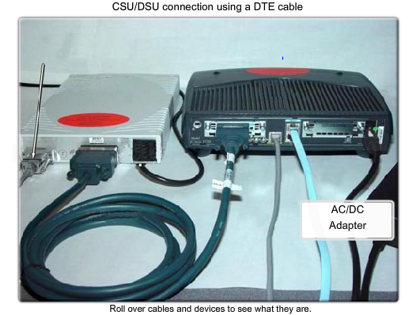
CSU/DSU

Slide 17
Interfaces
Configuring serial links in a lab environment
  One side of a serial connection must be considered a DCE
  This requires placing a clocking signal – use the clock rate command.
  Example:
    -R1(config)#interface serial 0/0
    -R1(config-if)#clockrate 64000
  Serial Interfaces require a clock signal to control the timing of the communcations.
Notes:
Use graphic 2.2.5.2 topology. If you can fit the router output that would be great but if not just use the topology

Slide 18
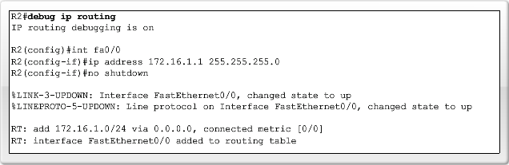
Routing Table and CDP Protocol
Purpose of the debug ip routing command
  Allows you to view changes that the router performs when adding or removing routes
  Example:
    -R2#debug ip routing
    -IP routing debugging is on
Notes:
Use graphic 2.3.1.2….in particular the “debug 1”

Slide 19
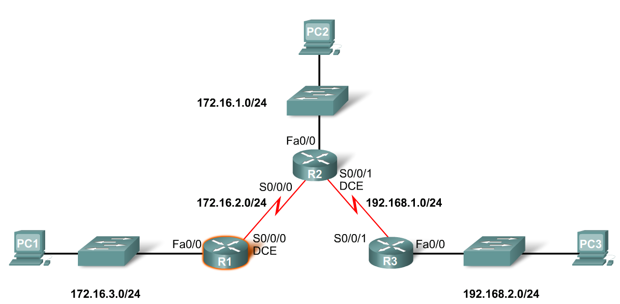
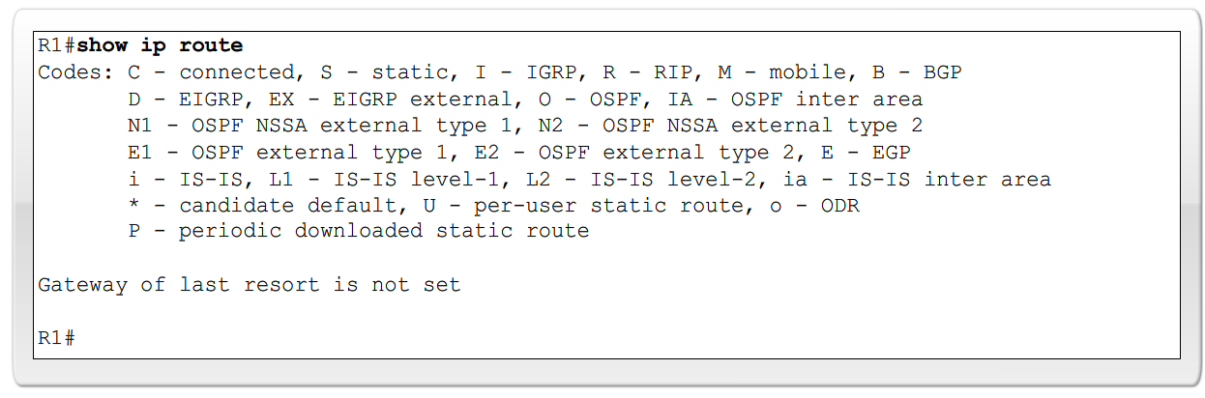
Routing Table and CDP Protocol
To configure an Ethernet interface
  Example:
    -R2(config)#interface fastethernet 0/0
    -R2(config-if)#ip address 172.16.1.1 255.255.255.0
    -R2(config-if)#no shutdown

Slide 20
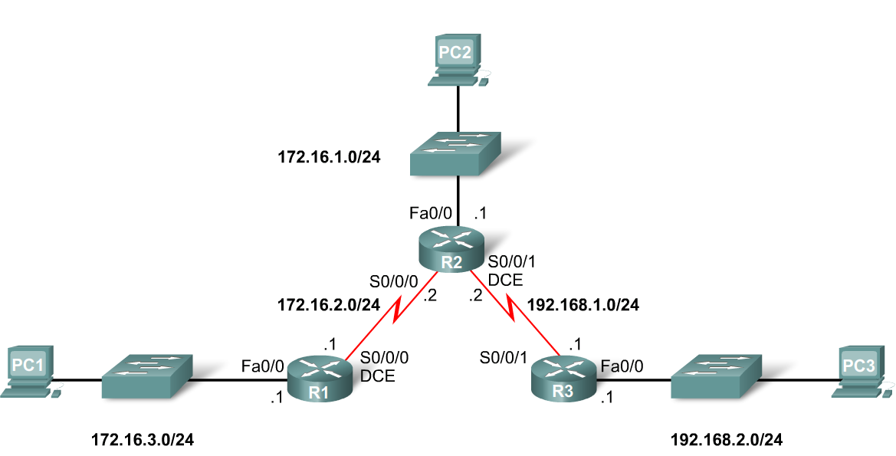
Routing Table and CDP Protocol
When a router only has its interfaces configured & no other routing protocols are configured then:
  -The routing table contains only the directly connected networks
  -Only devices on the directly connected networks are reachable

Slide 21
Verifying Connectivity
The crucial step in configuring your network is to verify that all the interfaces are "up" and "up" and that the routing tables are complete.
Regardless of what routing scheme you ultimately configure - static, dynamic, or a combination of both - verify your initial network configurations with the show ip interface brief command and the show ip route command before proceeding with more complex configurations.
When a router only has its interfaces configured, and the routing table contains the directly connected networks but no other routes, only devices on those directly connected networks are reachable.

Slide 22
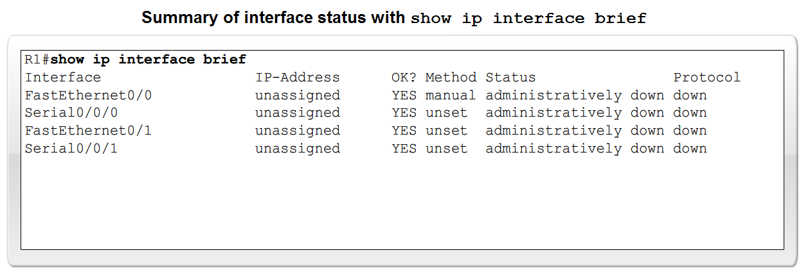
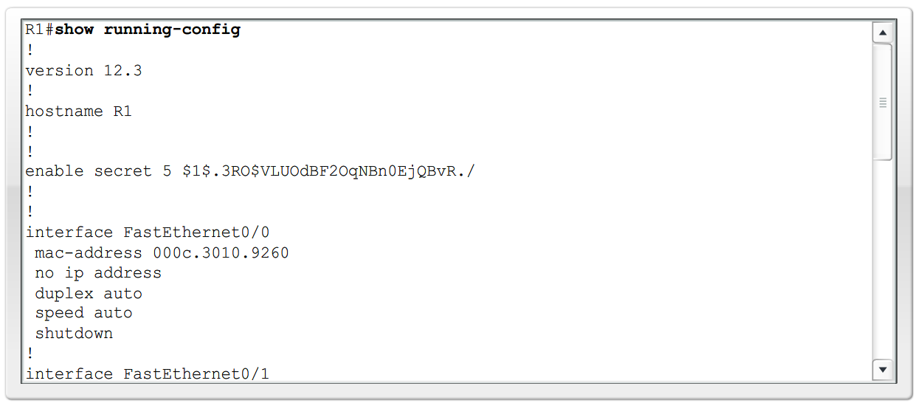
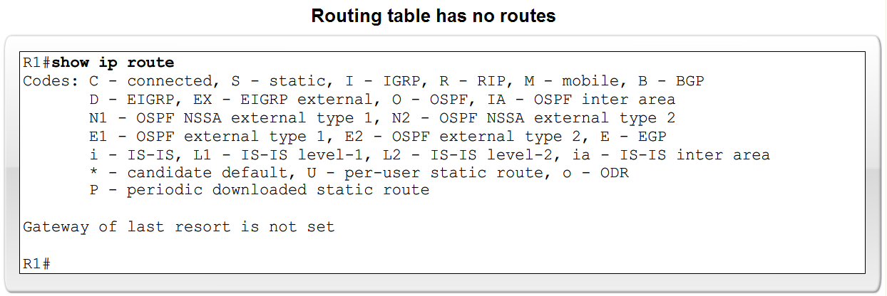
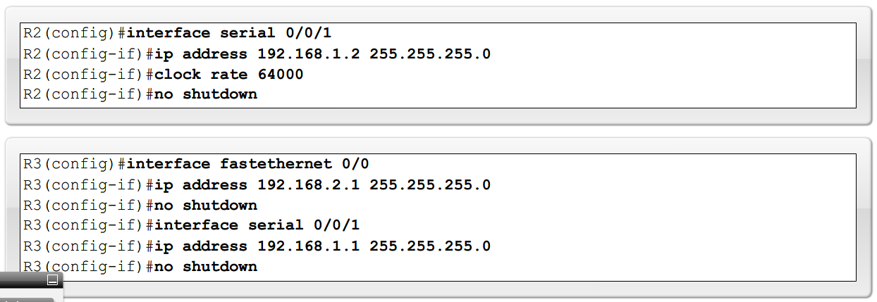
Routing Table and CDP Protocol

Slide 23
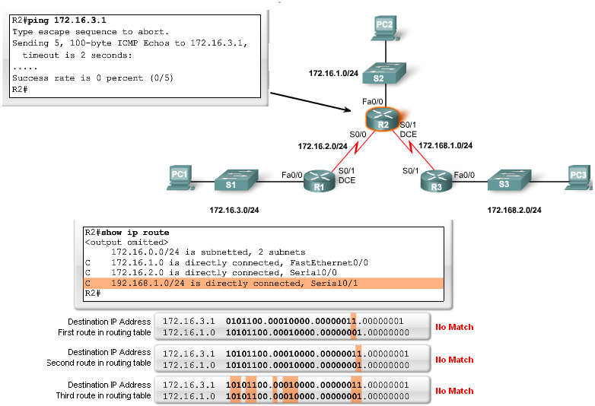
Routing Table and CDP Protocol
Checking each route in turn
  The ping command is used to check end to end connectivity

Slide 24
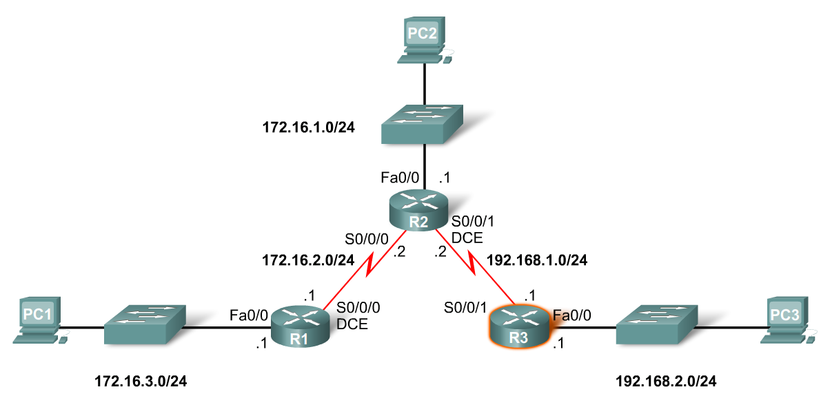
Routing Table and CDP Protocol
Purpose of CDP
  A layer 2 cisco proprietary tool used to gather information about other directly connected Cisco devices.
Concept of neighbors
  -2 types of neighbors
    Layer 3 neighbors
    Layer 2 neighbors
Notes:
Use graphic associated with CDP protocols (graphic 2.3.3.1)

Slide 25
Routing Table and CDP Protocol
CDP show commands
  Show cdp neighbors command
    -Displays the following information:
      Neighbor device ID
      Local interface
      Holdtime value, in seconds
      Neighbor device capability code
      Neighbor hardware platform
      Neighbor remote port ID
  Show cdp neighbors detail command
    -Useful in determining if an IP address configuration error

Slide 26
Routing Table and CDP Protocol
How it works
CDP runs at the Data Link layer connecting the physical media to the upper-layer protocols (ULPs).
Because CDP operates at the Data Link layer, two or more Cisco network devices, such as routers that support different Network layer protocols (for example, IP and Novell IPX), can learn about each other.
When a Cisco device boots up, CDP starts up by default. CDP automatically discovers neighboring Cisco devices running CDP, regardless of which protocol or suites are running. CDP exchanges hardware and software device information with its directly connected CDP neighbors.
Disabling CDP
  To disable CDP globally use the following command
    Router(config)#no cdp run
Notes:
Use router output graphic 2.3.4.1 (all 3) – this will cover this slide and the previous slide

Slide 27
Static Routes with Exit Interfaces
Purpose of a static route
  A manually configured route used when routing from a network to a stub network
  A stub network is a network accessed by a single route.
  For an example, see the figure. Here we see that any network attached to R1 would only have one way to reach other destinations, whether to networks attached to R2 or to destinations beyond R2.
  Therefore, network 172.16.3.0 is a stub network and R1 is a stub router.
  Running a routing protocol between R1 and R2 is a waste of resources because R1 has only one way out for sending non-local traffic. Therefore, static routes are configured for connectivity to remote networks that are not directly connected to a router.

Slide 28
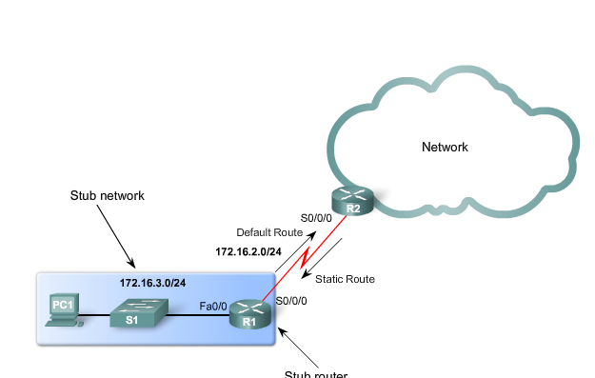
Stub Network

Slide 29
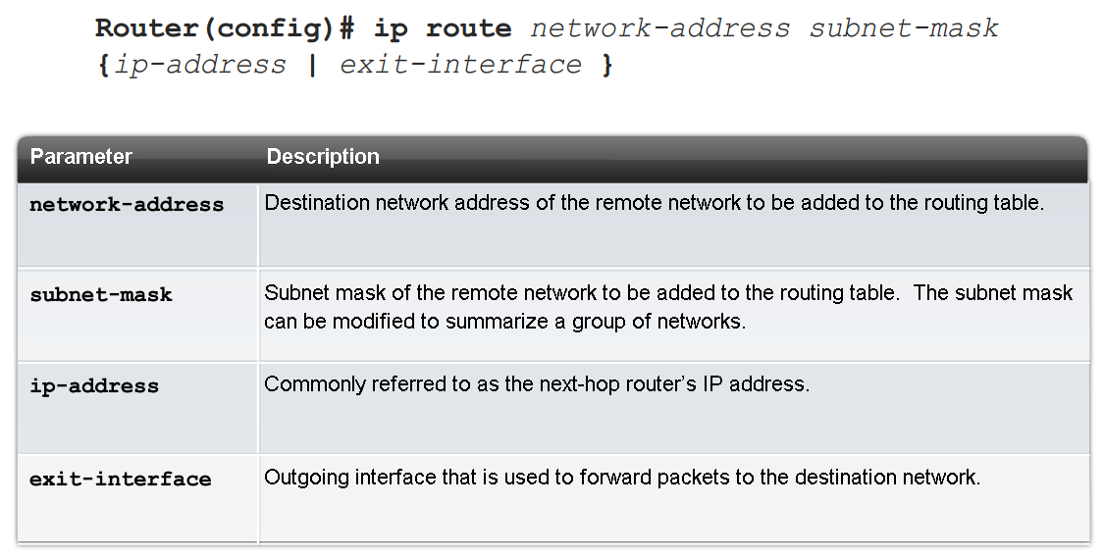
Static Routes with Exit Interfaces
IP route command
  To configure a static route use the following command: ip route
  Example:
    -Router(config)# ip route network-address subnet-mask {ip-address | exit-interface }

Slide 30

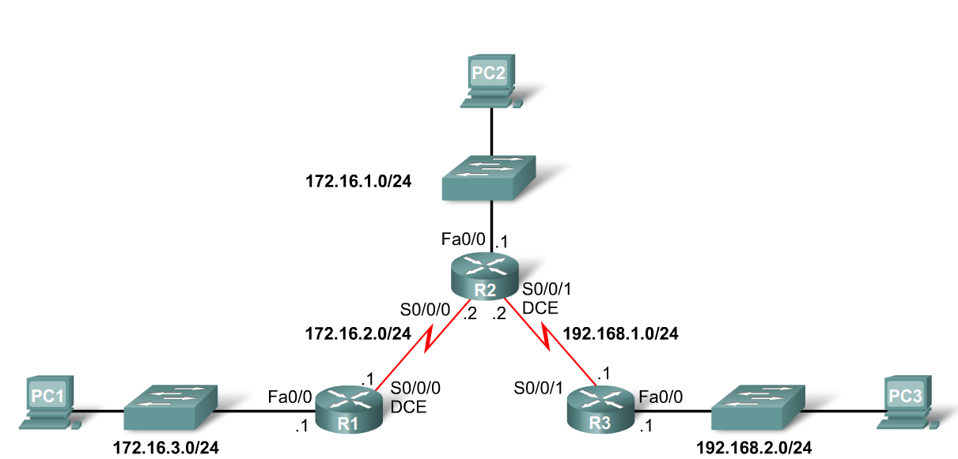
Static Routes with Exit Interfaces
Dissecting static route syntax
  ip route - Static route command
  172.16.1.0 – Destination network address
  255.255.255.0 - Subnet mask of destination network
  172.16.2.2 - Serial 0/0/0 interface IP address on R2, which is the "next-hop" to this network

Slide 31
Static Routes with Exit Interfaces
Configuring routes to 2 or more remote networks
  Use the following commands for R1
    -R1(config)#ip route 192.168.1.0 255.255.255.0 172.16.2.2
    -R1(config)#ip route 192.168.2.0 255.255.255.0 172.16.2.2

Slide 32
Static Routes with Exit Interfaces
Zinin’s 3 routing principles
  Principle 1: "Every router makes its decision alone, based on the information it has in its own routing table.“
  Principle 2: "The fact that one router has certain information in its routing table does not mean that other routers have the same information.“
  Principle 3: "Routing information about a path from one network to another does not provide routing information about the reverse, or return path."

Slide 33
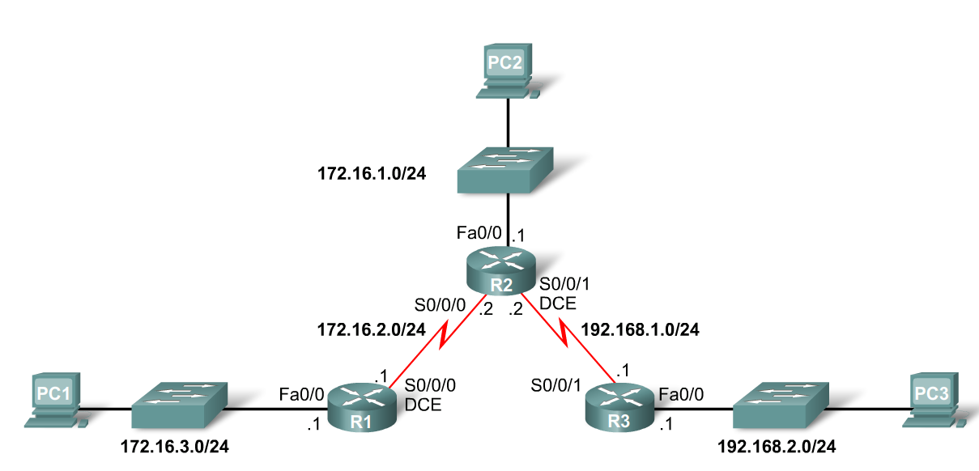
Static Routes with Exit Interfaces
Using Zinin’s 3 routing principles, how would you answer the following?
  -Would packets from PC1 reach their destination?
    Yes, packets destined for 172.16.1.0/24 and 192.168.1.0/24 networks would reach their destination.
  -Does this mean that any packets from these networks destined for 172.16.3.0/24 network will reach their destination?
    No, because neither R2 nor R3 router has a route to the 172.16.3.0/24 network.

Slide 34

Static Routes with Exit Interfaces
Resolving to an Exit Interface
  -Before any packet is forwarded by a router, the routing table process must determine the exit interface to use to forward the packet. This is known as route resolvability.
  Recursive route lookup - Occurs when the router has to perform multiple lookups in the routing table before forwarding a packet. A static route that forwards all packets to the next-hop IP address goes through the following process (reclusive route lookup)
    The router first must match static route’s destination IP address with the Next hop address
    The next hop address is then matched to an exit interface

Slide 35
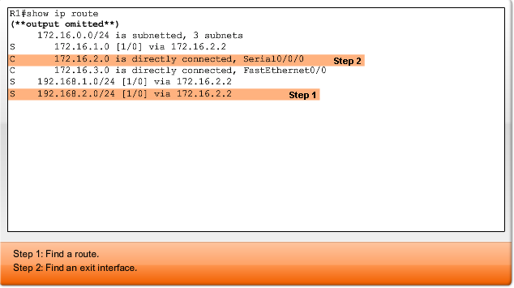
Example
The 172.16.2.0 route is a directly connected network with the exit interface Serial 0/0/0.
This lookup tells the routing table process that this packet will be forwarded out that interface.
Therefore, it actually takes two routing table lookup processes to forward any packet to the 192.168.2.0/24 network.
When the router has to perform multiple lookups in the routing table before forwarding a packet, it is performing a process known as a recursive lookup.

Slide 36
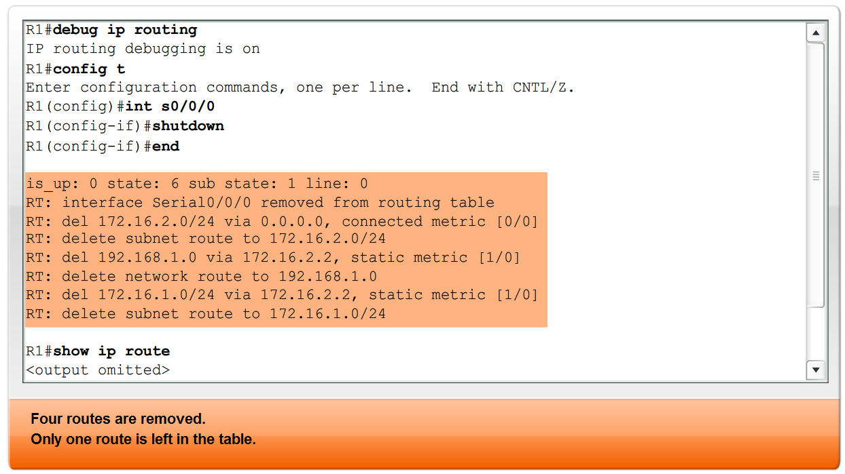
Static Routes with Exit Interfaces
Configuring a Static route with an Exit Interface
  -Static routes configured with an exit interface are more efficient
  The routing table can resolve the exit interface in a single search instead of 2 searches
  -Example of syntax require to configure a static route with an exit interface

Slide 37
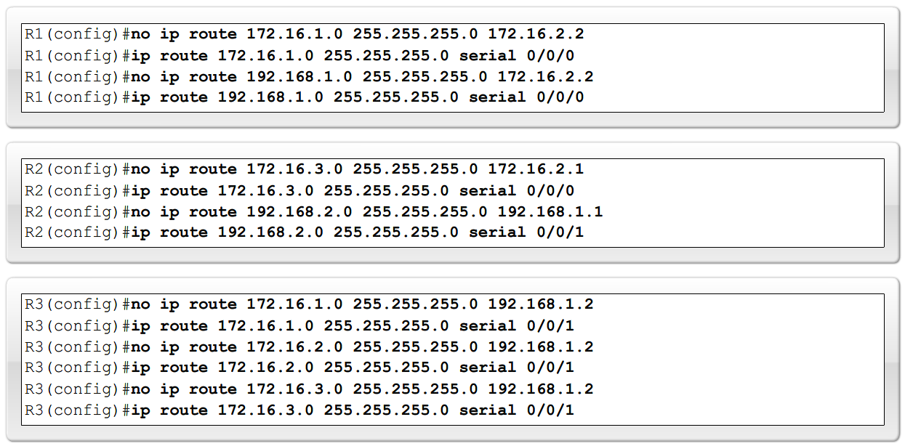
Static Routes with Exit Interfaces
Modifying Static routes
  Existing static routes cannot be modified. The old static route must be deleted by placing no in front of the ip route
  Example:
    -no ip route 192.168.2.0 255.255.255.0 172.16.2.2
  A new static route must be rewritten in the configuration

Slide 38
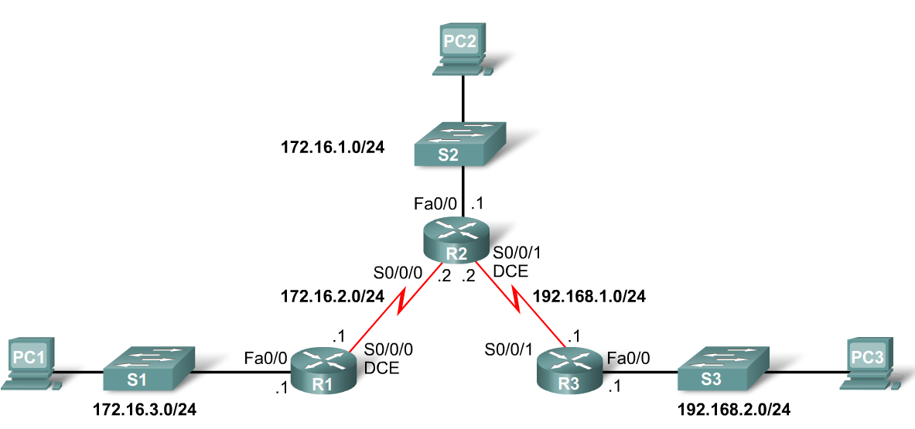
Static Routes with Exit Interfaces
Verifying the Static Route Configuration
  -Use the following commands
    Step 1 show running-config
    Step 2 verify static route has been entered correctly
    Step 3 show ip route
    Step 4 verify route was configured in routing table
    Step 5 issue ping command to verify packets can reach destination and that Return path is working

Slide 39
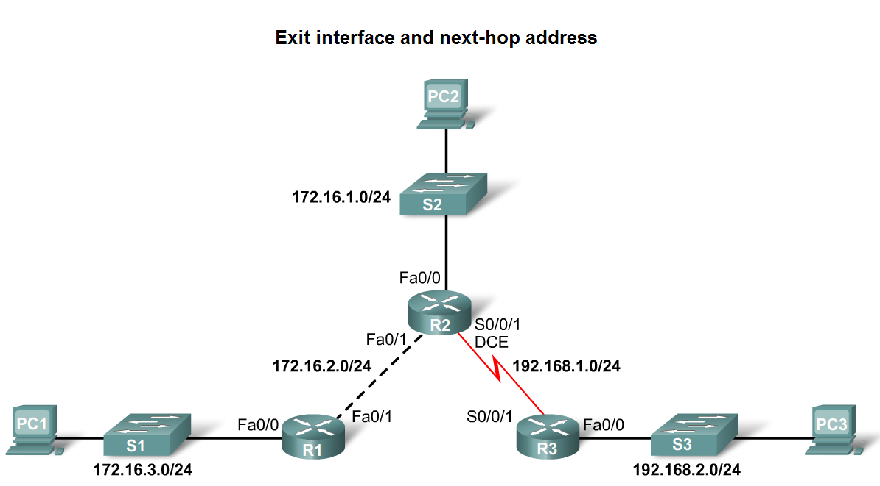
Static Routes with Exit Interfaces
Ethernet interfaces and ARP.
  If a static route is configured on an Ethernet link
  -If the packet is sent to the next-hop router then…
  the destination MAC address will be the address of the next hop’s Ethernet interface
  This is found by the router consulting the ARP table.
  If an entry isn’t found then an ARP request will be sent out

Slide 40
Summary and Default Route
Summarizing routes reduces the size of the routing table.
Route summarization is the process of combining a number of static routes into a single static route.
Notes:
Use graphic 2.6.1.1.

Slide 41
Summarising Routes
Creating smaller routing tables makes the routing table lookup process more efficient, because there are fewer routes to search.
If one static route can be used instead of multiple static routes, the size of the routing table will be reduced. In many cases, a single static route can be used to represent dozens, hundreds, or even thousands of routes.
We can use a single network address to represent multiple subnets.
For example, the networks 10.0.0.0/16, 10.1.0.0/16, 10.2.0.0/16, 10.3.0.0/16, 10.4.0.0/16, 10.5.0.0/16, all the way through 10.255.0.0/16 can be represented by a single network address: 10.0.0.0/8.

Slide 42
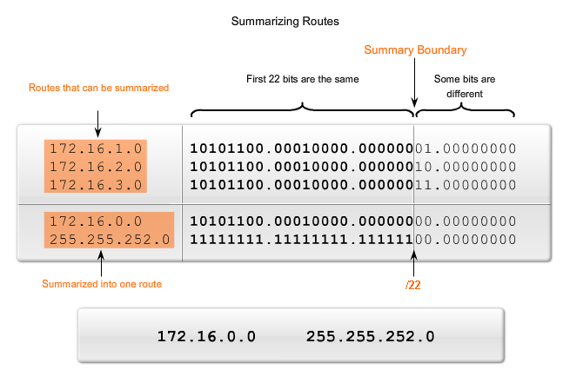
Summarizing Routes

Slide 43
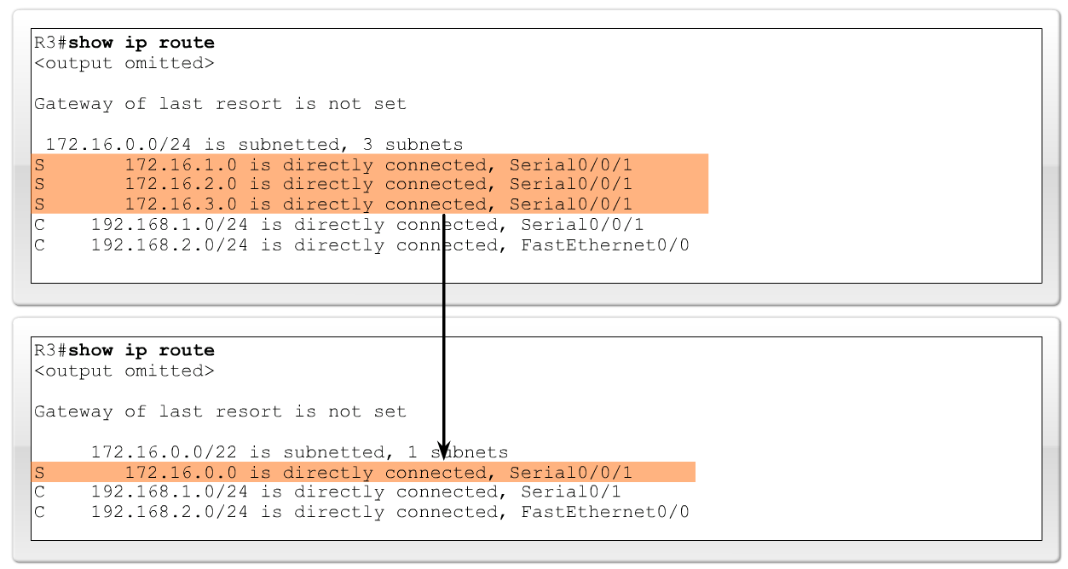
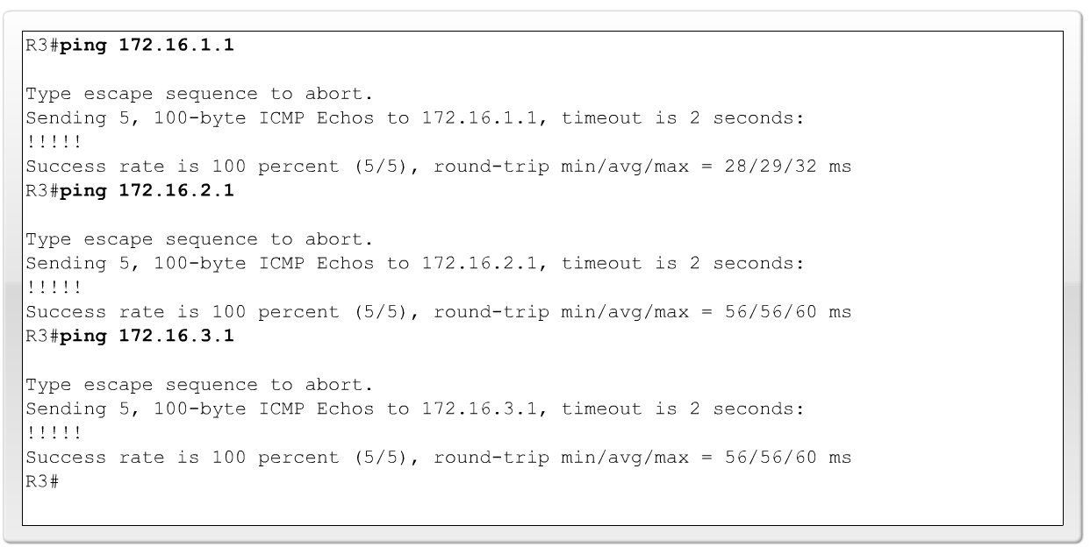
Summary and Default Route
Configuring a summary route
  Step 1: Delete the current static route
  Step 2: Configure the summary static route
  Step 3: Verify the new static route

Slide 44
Summary and Default Route
Default Static Route
  This is a route that will match all packets. Stub routers that have a number of static routes all exiting the same interface are good candidates for a default route.
    -Like route summarization this will help reduce the size of the routing table
Configuring a default static route
  Similar to configuring a static route. Except that destination IP address and subnet mask are all zeros
  Example:
    -Router(config)#ip route 0.0.0.0 0.0.0.0 [exit-interface | ip-address ]

Slide 45
Summary and Default Route
Static routes and subnet masks
  The routing table lookup process will use the most specific match when comparing destination IP address and subnet mask
Default static routes and subnet masks
  Since the subnet mask used on a default static route is 0.0.0.0 all packets will match.
Notes:
Use graphic 2.6.2.2

Slide 46
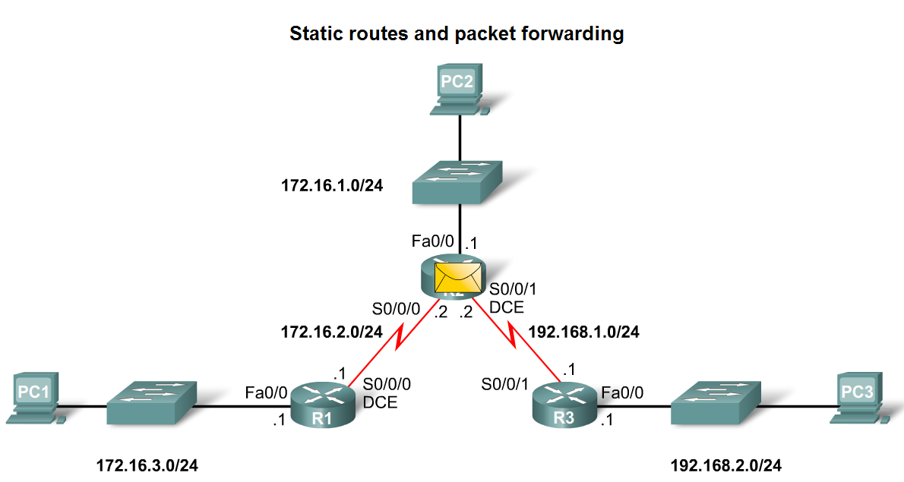
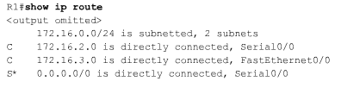
Static Routes and Packet Forwarding
Packet forwarding with static routes. (recall Zinin’s 3 routing principles)
Router 1
  Packet arrives on R1’s Fastethernet 0/0 interface
  R1 does not have a route to the destination network, 192.168.2.0/24
  R1 uses the default
  static route.

Slide 47
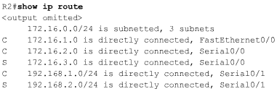

Static Routes and Packet Forwarding
Packet forwarding with static routes. (recall Zinin’s 3 routing principles)
Router 2
  The packet arrives on the Serial 0/0/0 interface on R2.
  R2 has a static route to 192.168.2.0/24 out Serial0/0/1.

Slide 48
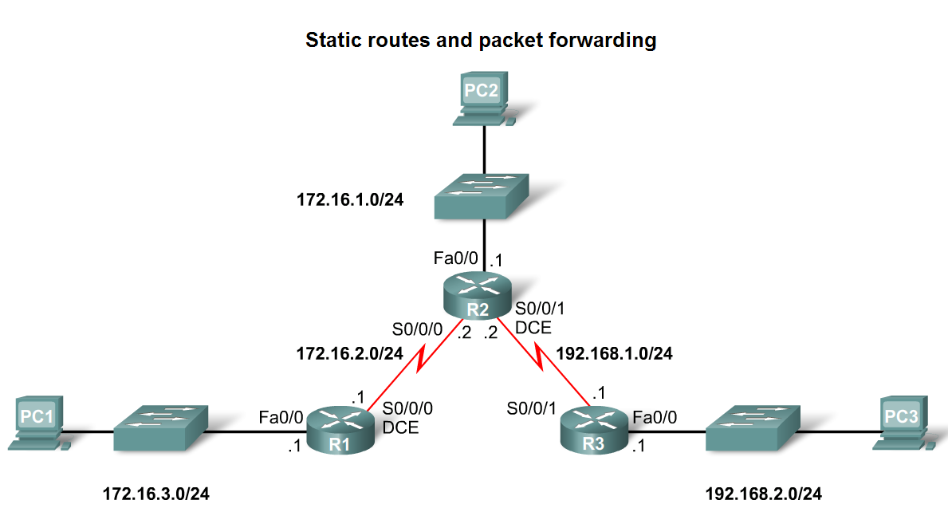
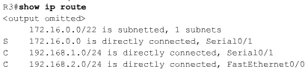
Static Routes and Packet Forwarding
Packet forwarding with static routes. (recall Zinin’s 3 routing principles)
Router 3
  The packet arrives on the Serial0/0/1 interface on R3.
  R3 has a connected route to 192.168.2.0/24 out Fastethernet 0/1.

Slide 49
Missing Routes
Networks are subject to many different forces that can cause their status to change quite often:
An interface fails.
A service provider drops a connection.
There is an over-saturation of links.
An administrator enters a wrong configuration.
When there is a change in the network, connectivity may be lost. As a network administrator, you are the one responsible for pinpointing and solving the problem.

Slide 50
Static Routes and Packet Forwarding
Troubleshooting a Missing Route
Tools that can be used to isolate routing problems include:
  -Ping– tests end to end connectivity
  -Traceroute– used to discover all of the hops (routers) along the path between 2 points
  -Show IP route– used to display routing table & ascertain forwarding process
  -Show ip interface brief- used to show status of router interfaces
  -Show cdp neighbors detail– used to gather configuration information about directly connected neighbors

Slide 51
Static Routes and Packet Forwarding
Solving a Missing Route
Finding a missing or mis-configured route requires methodically using the correct tools
  -Start with PING. If ping fails then use traceroute to determine where packets are failing to arrive
Issue: show ip route to examine routing table.
  -If there is a problem with a mis-configured static route remove the static route then reconfigure the new static route

Slide 52
Summary
Routers
  -Operate at layer 3
  -Functions include best path selection & forwarding packets
Connecting Networks
  WANs
    Serial cables are connected to router serial ports.
    In the lab environment clock rates must be configured for DCE
  LANs
    Straight through cables or cross over cables are used to connect to fastethernet port. (The type of cable used depends on what devices are being connected)
Cisco Discovery Protocol
  A layer 2 proprietary protocol
  Used to discover information about directly connected Cisco devices

Slide 53
Summary
Static Routes
  -This is a manually configured path that specifies how the router will get to a certain point using a certain path.
Summary static routes
  -This is several static routes that have been condensed into a single static route.
Default route
  -It is the route packets use if there is no other possible match for their destination in the routing table.
Forwarding of packets when static route is used
  -Zinin’s 3 routing principles describe how packets are forwarded
Troubleshooting static routes may require some of the following commands:
  -Ping
  -Traceroute
  -Show IP route
  -Show ip interface brief
  -Show cdp neighbors detail

